Slide 1
A Comparison of Time Series Models to Predict COVID-19 Cases
Kenny Lau, Eddie Aung, Elaine Pranadjaya, Wittawat Chailiab

Slide 2
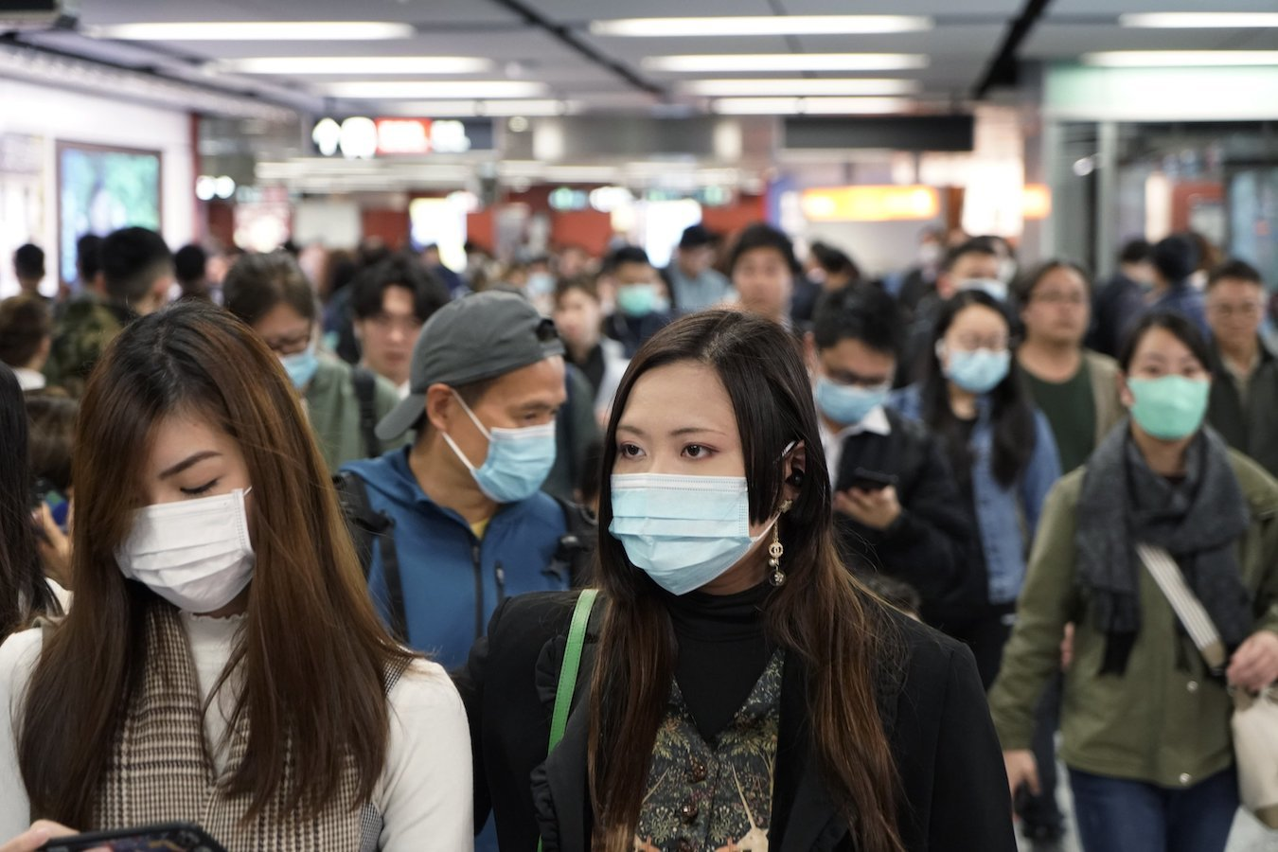
Devastating Effects of COVID-19
As of November 29th, 2020 there are...
63,066,168 cases worldwide
1,465,048 deaths worldwide
It has completely changed our daily lives and how we interact with people
Is it possible to accurately determine number of future cases using statistical/machine learning models?
If so, countries can optimize usage of national resources and lead to quick recover for the global health and economy

Slide 3
Project Overview
Using a COVID-19 dataset and different time series models, we will apply our knowledge of supervised learning regressions to try to accurately predict new cases
We will be using the following models:
Linear Regression
Autoregressive Integrated Moving Average (ARIMA)
Bayesian Ridge Regression
Support Vector Regressor
Holt’s Linear Trend
Visualize and compare the different models

Slide 4
COVID-19 Data Attributes
Lots of attributes with general information about country
Continent
Location
Population
Population Density
Median Age
% of Population Over 65
% of Population Over 70
GDP per capita
And many more attributes
Each country also had an attribute with JSON formatted data of the number of cases for the corresponding date

Slide 5
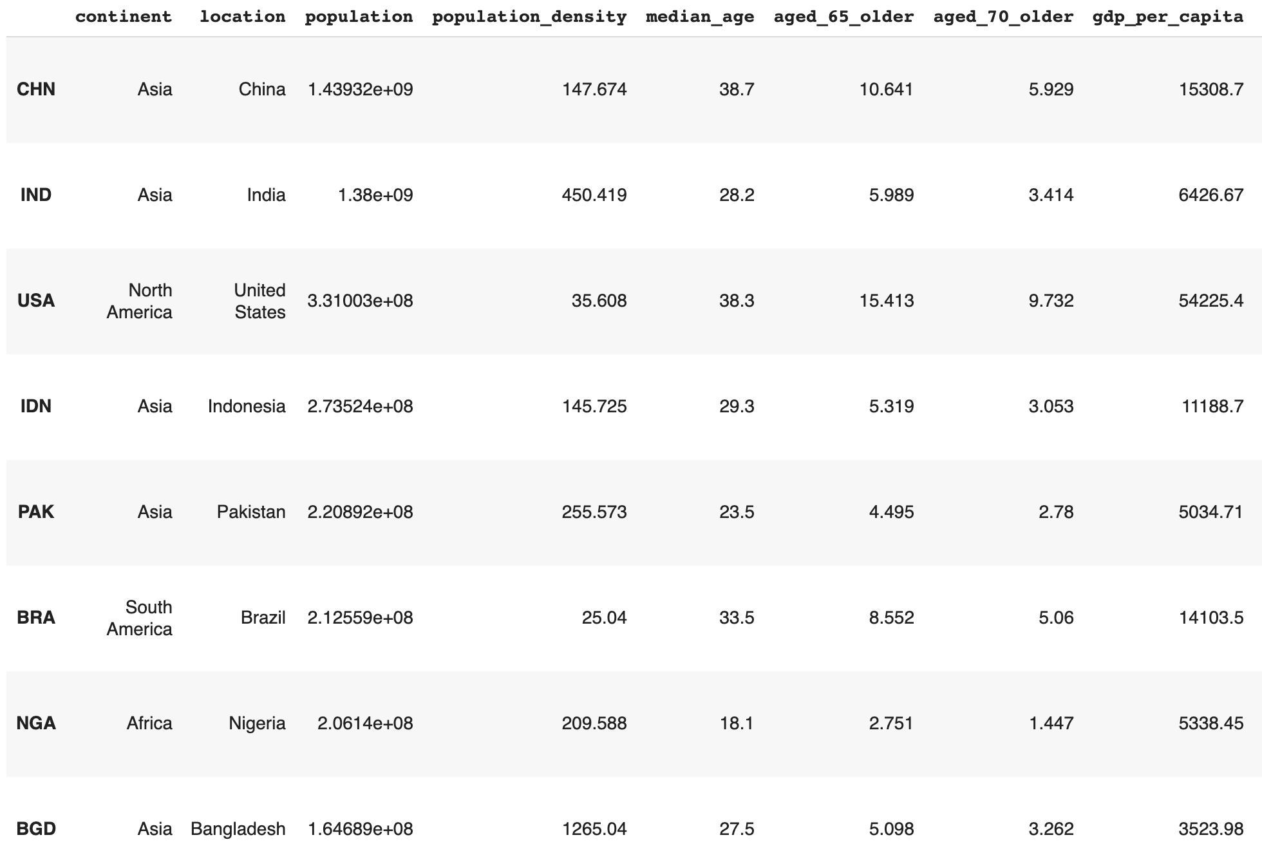

Slide 6
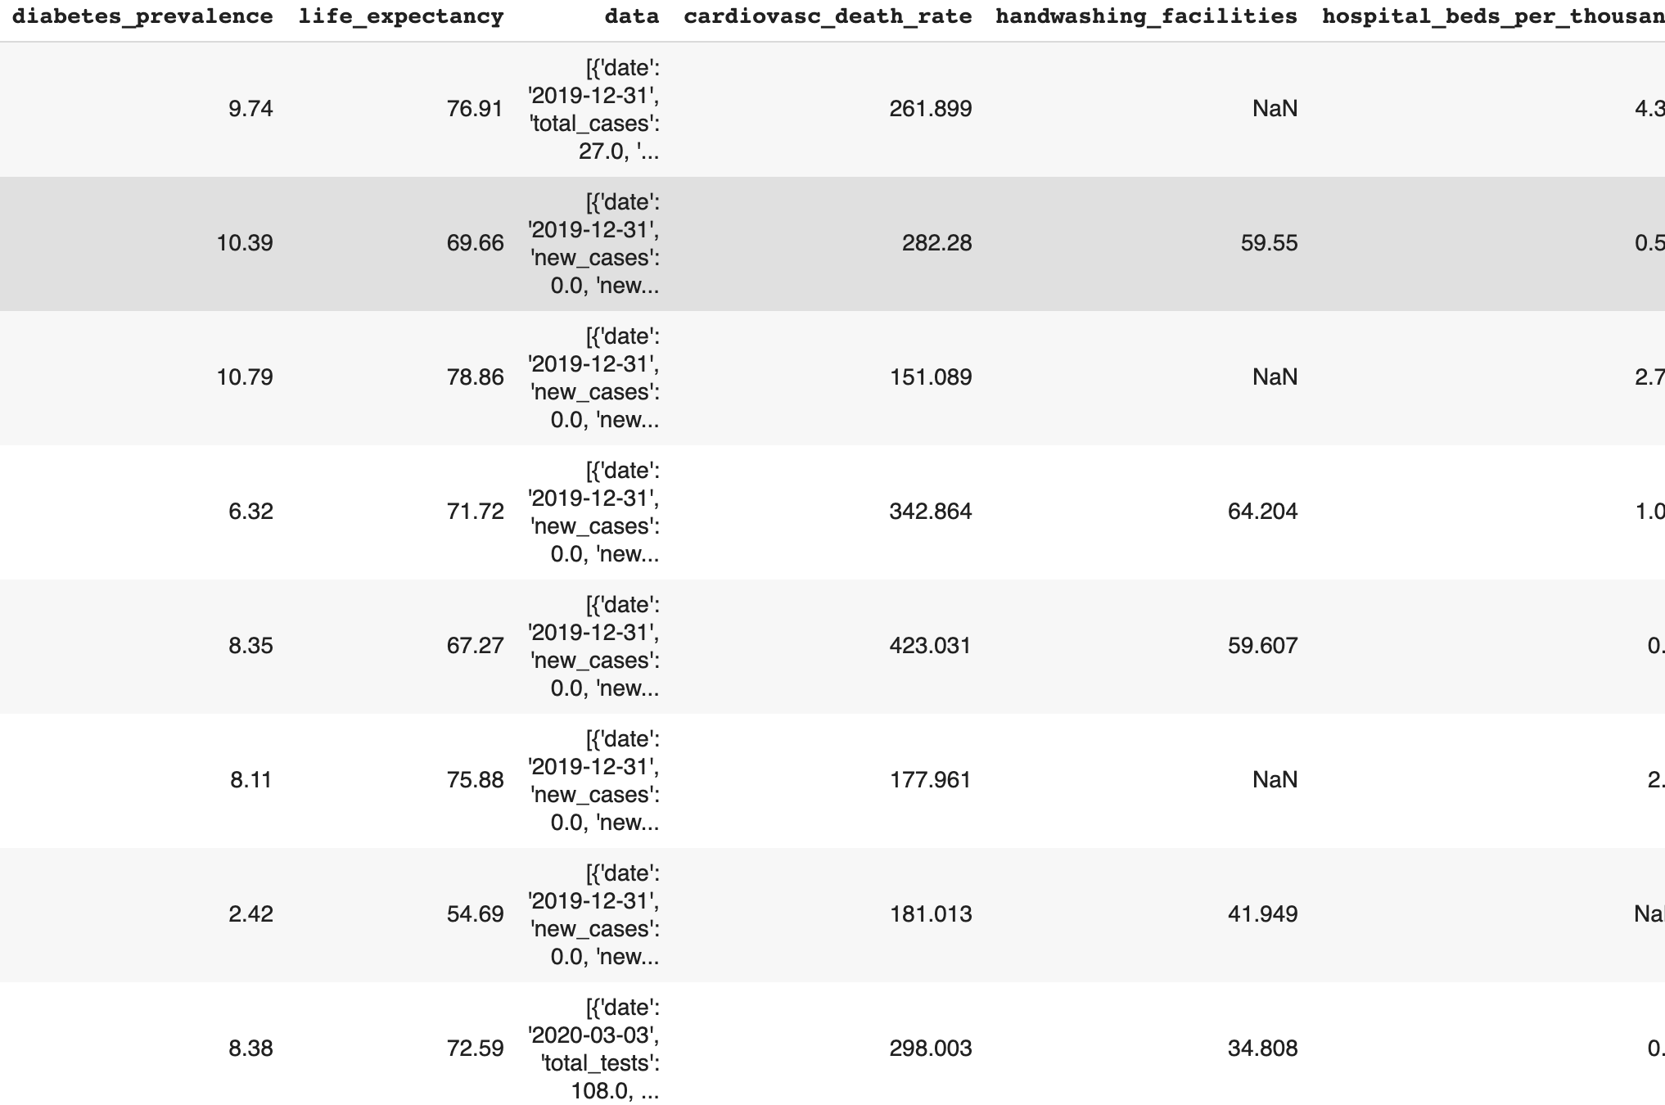

Slide 7
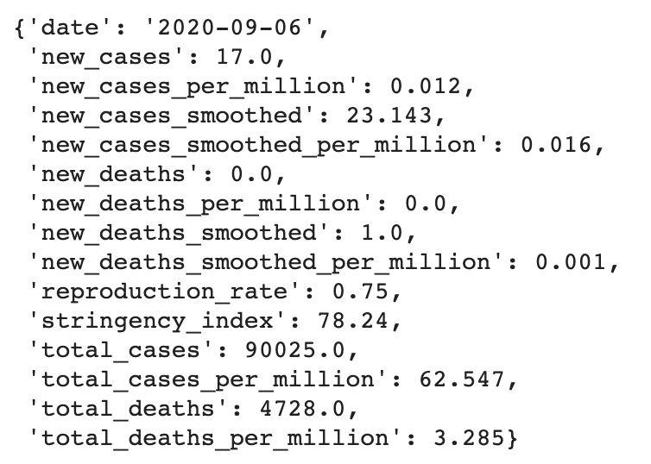

Slide 8
What We First Tried
Maybe all the attributes for each country can be used in a ML model to predict the average number of new cases
If this is true we can...
Cleaned up the data
Find the correlations between all the attributes and average new cases
Apply different ML models (KNN, Neural Network, Regression) to data
Compare results

Slide 9
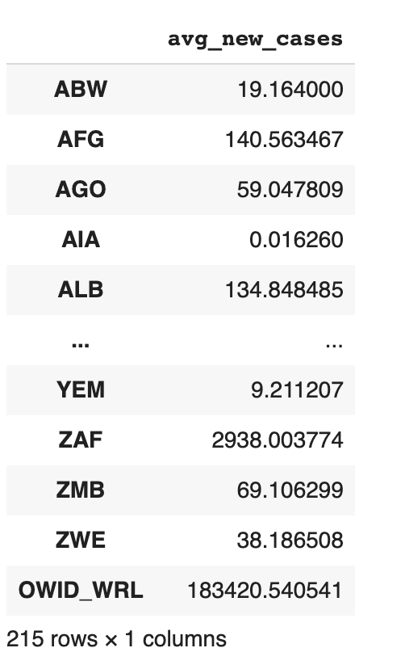
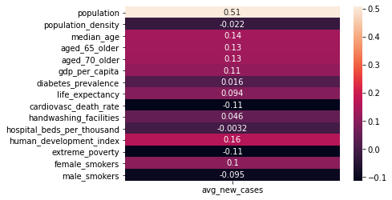

Slide 10
What We Ended Up Doing
We learned that there was no correlation between the average new cases and all the attributes from the dataset
We can still use Time Series Forecasting to predict future new cases
Time series forecasting: The use of a model to predict future values based on previously observed values
Picked the 5 most popular time series methods
The goal was to find the model that provided the most accurate results for the 10 most populated countries

Slide 11
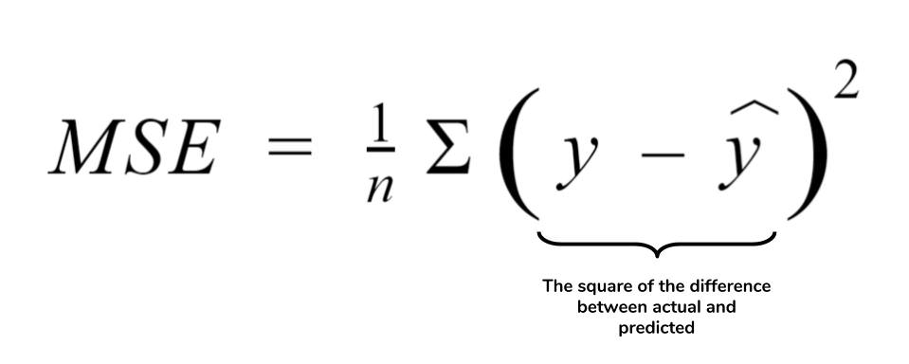
What We Ended Up Doing
Train with 96% of the data and test with remaining 4%
Calculated the Mean Squared Error for each country with respective model
Visualized data to compare actual to predicted values
Final comparison between all models to find the model that was the most accurate

Slide 12
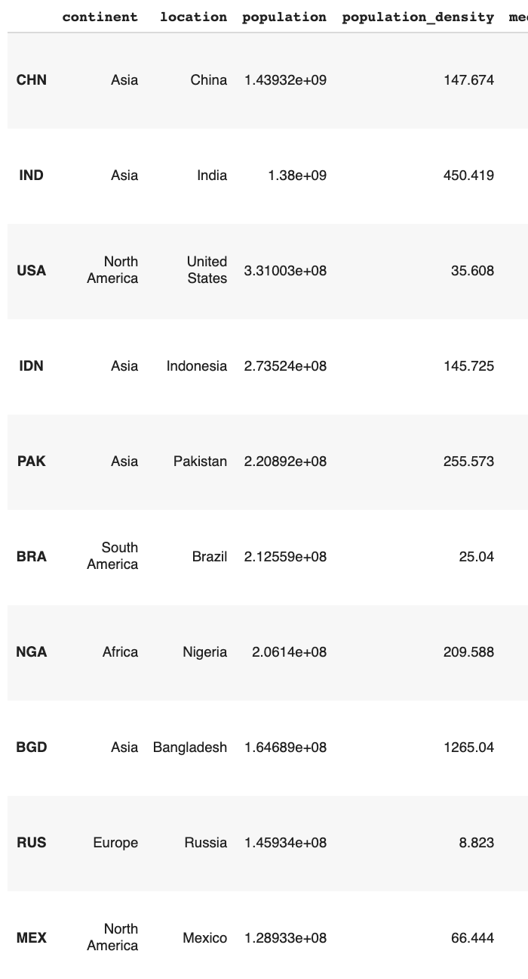

Slide 13
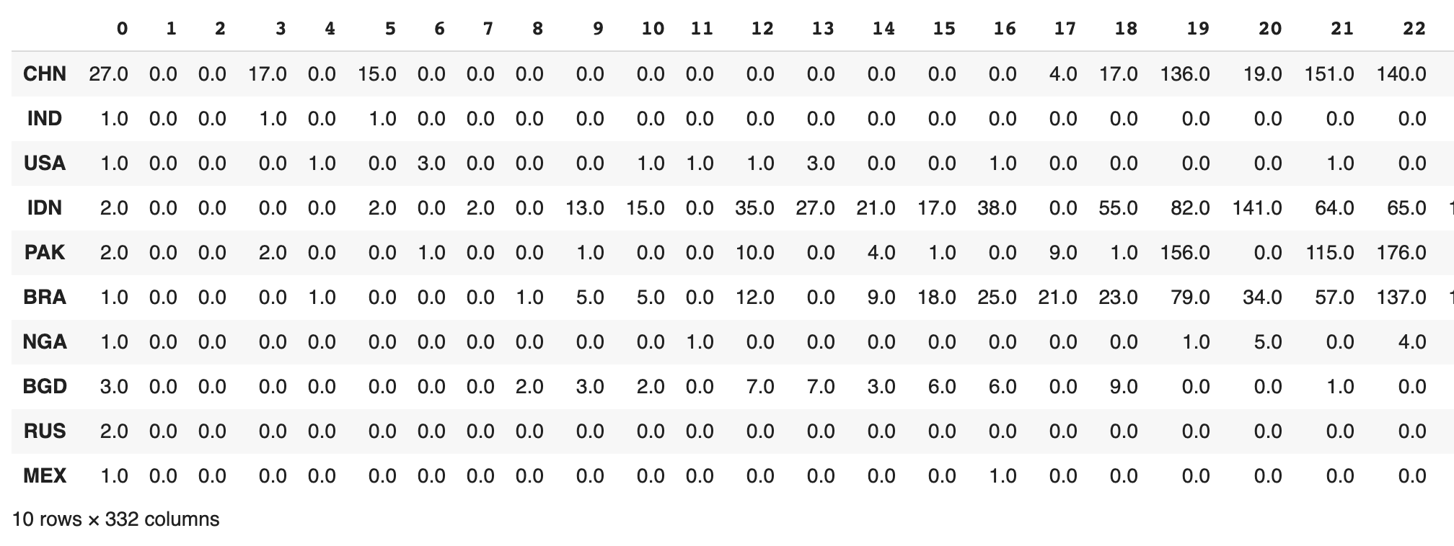
First Column (0) = 12-31-2019
Last Column (331) = 11-26-2020
Notes:
Null data was from some countries who stopped reporting later on because they had minimal cases
-they were dropped from our model and predictions

Slide 14
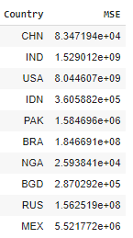
Bayesian Ridge Regression
Type of linear regression.
Reflects the Bayesian framework: forming an initial estimate and then improving the estimate as more data is gathered.
Bayesian regression is able to deal with insufficient data or poorly distributed data by formulating linear regression using probability distributors rather than point estimates.

Slide 15
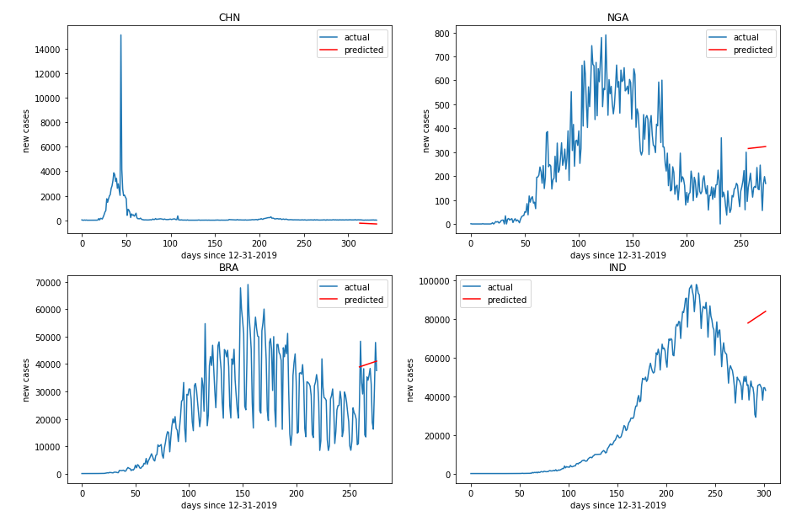
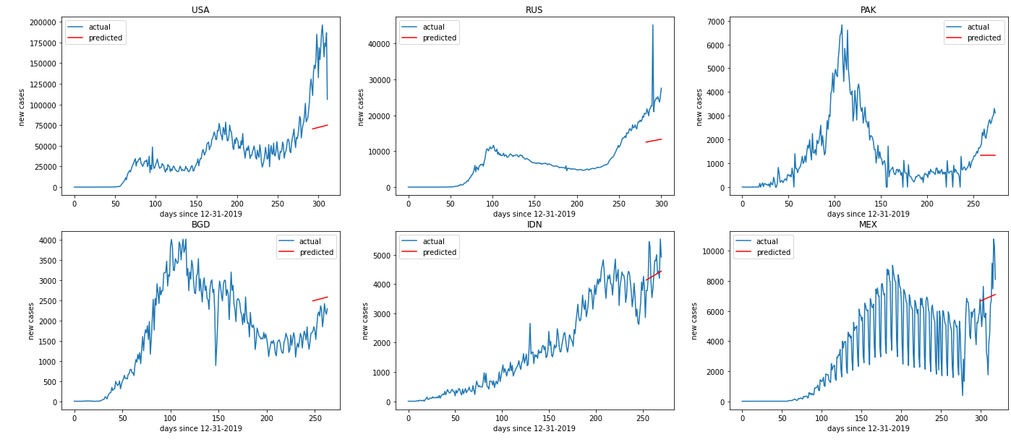

Slide 16
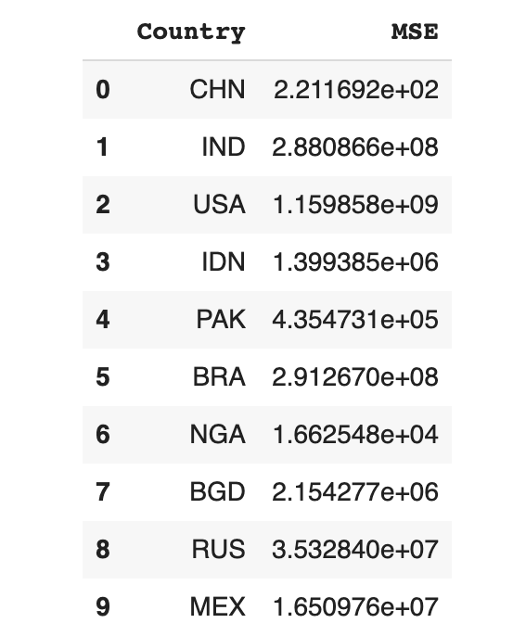
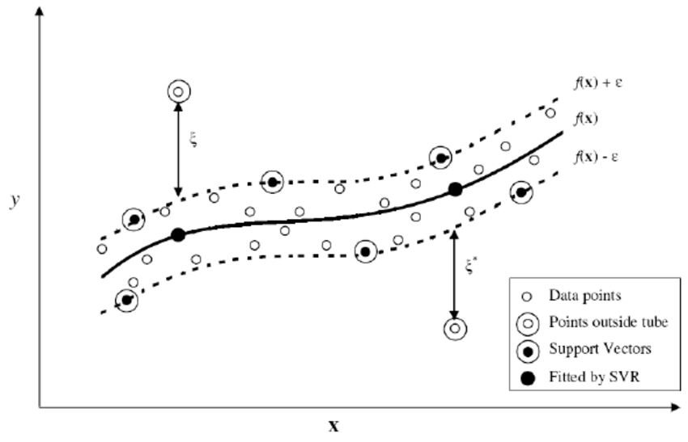
Support Vector Regression
Developed from Support Vector Machine (SVM) for regression analysis.
Decide a Hyperplane(best fit line) and draw a boundary line along the Hyperplane.

Slide 17
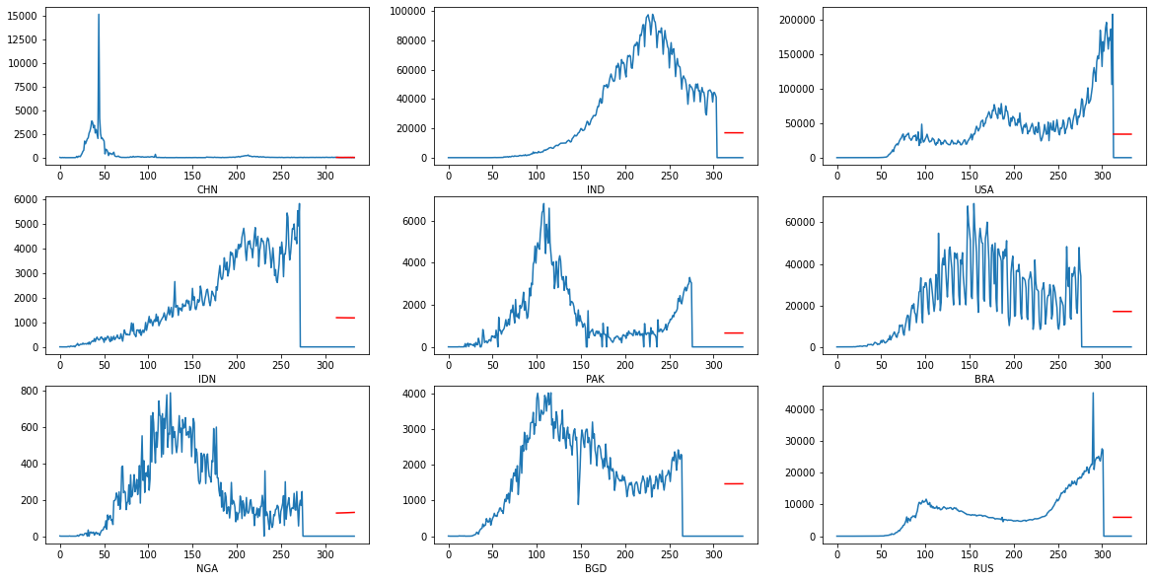

Slide 18
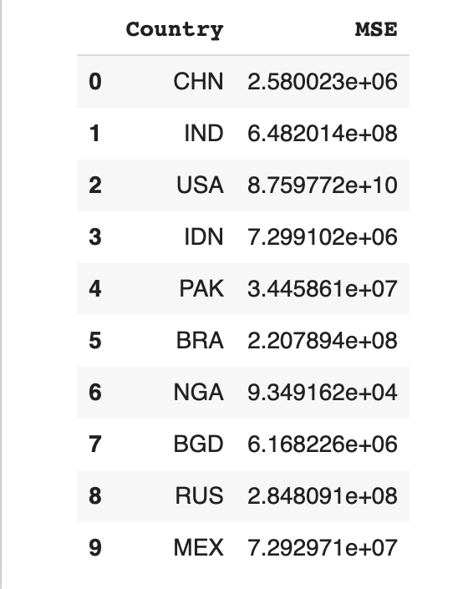
Linear Regression (Polynomial)
Statistical method for predictive analysis.
Show linear relationship between variables (dependent and independents).
Apply polynomial regression for better accuracy.

Slide 19
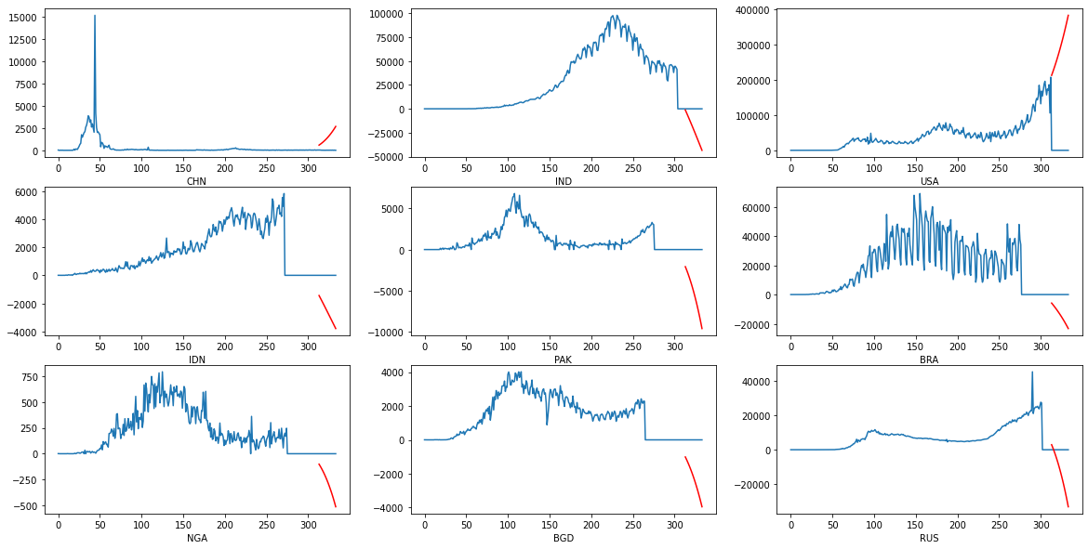

Slide 20
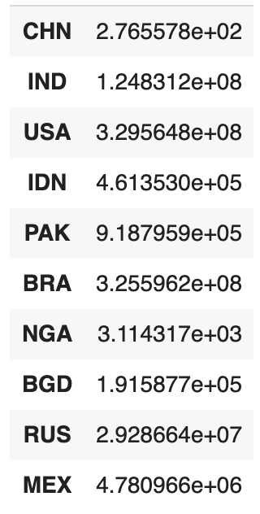
Holt’s Linear Trend
AKA Holt-Winter Exponential Smoothing
Uses exponential smoothing to encode values from the past
Uses the past data to predict “typical” values for present data

Slide 21
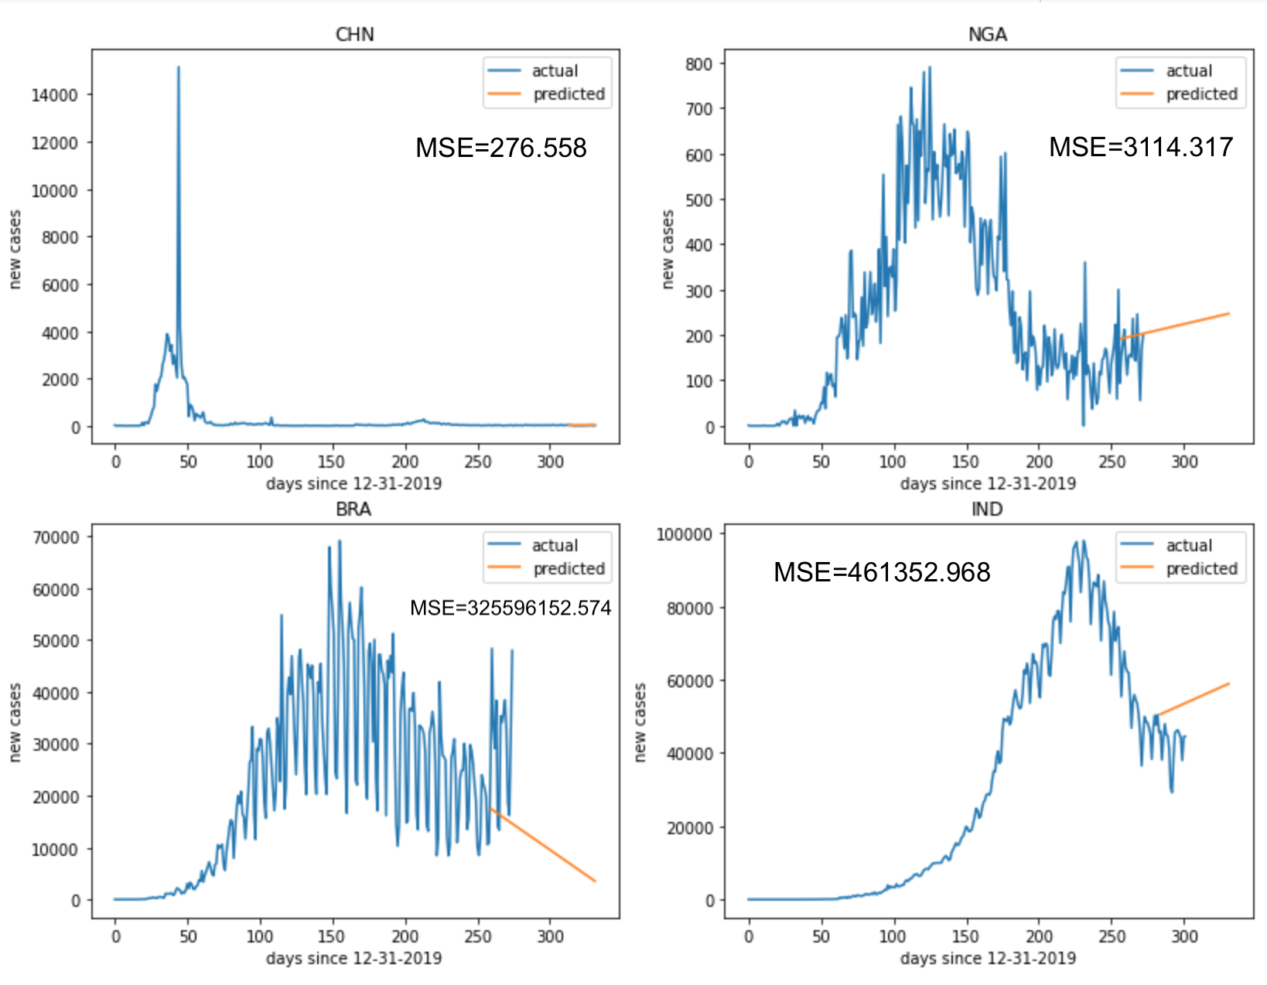
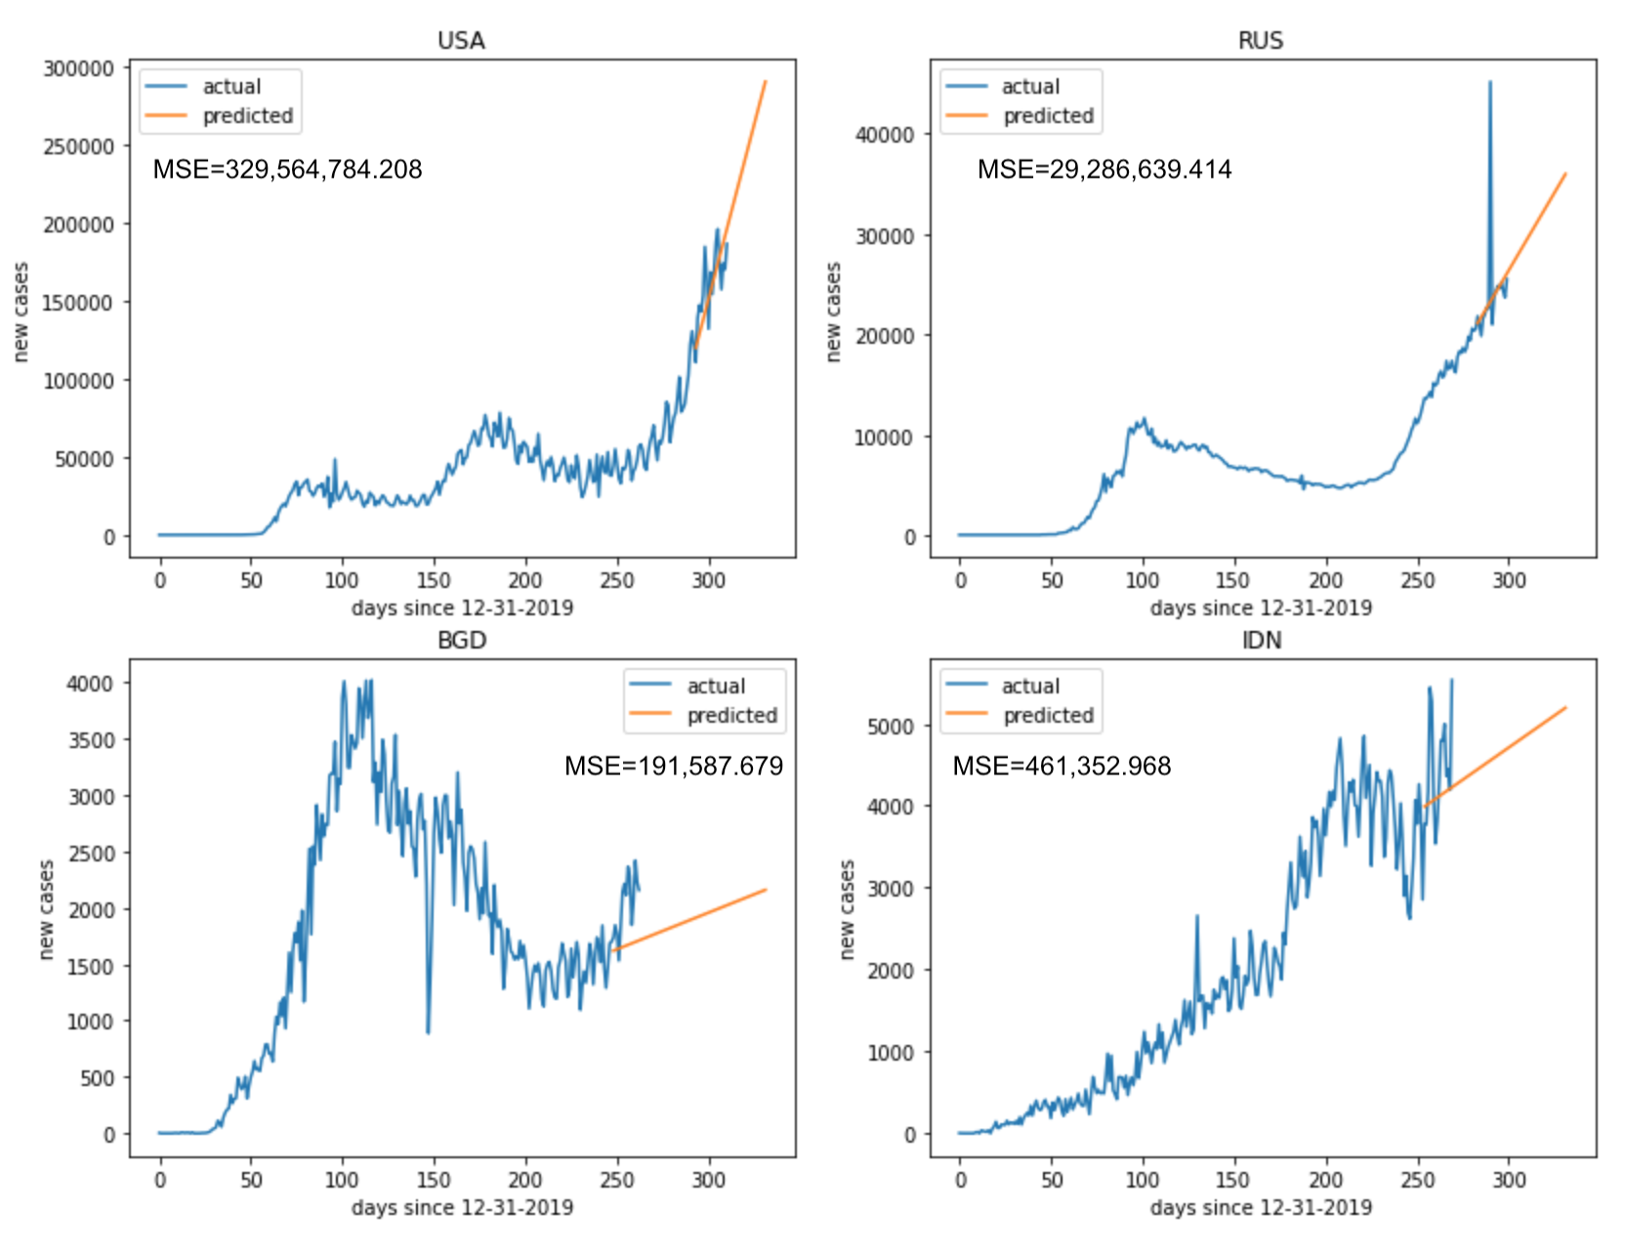

Slide 22
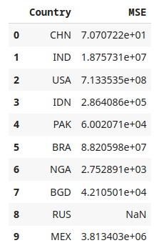
Autoregressive Integrated Moving Average
Contains two components
Autoregression (AR)
Moving average (MA)
AR regresses on its own lagged or prior values while MA incorporates dependency between an observation and residual error
Effective in predicting value changes on intervals

Slide 23
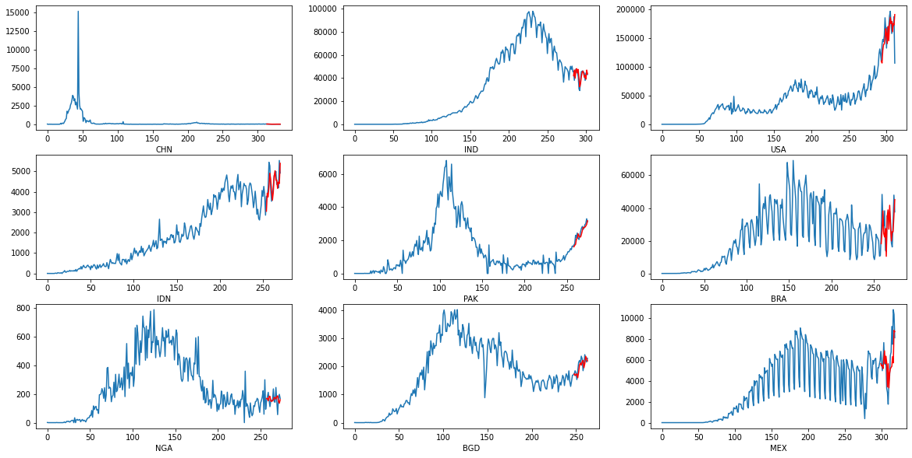

Slide 24
Results

Slide 25
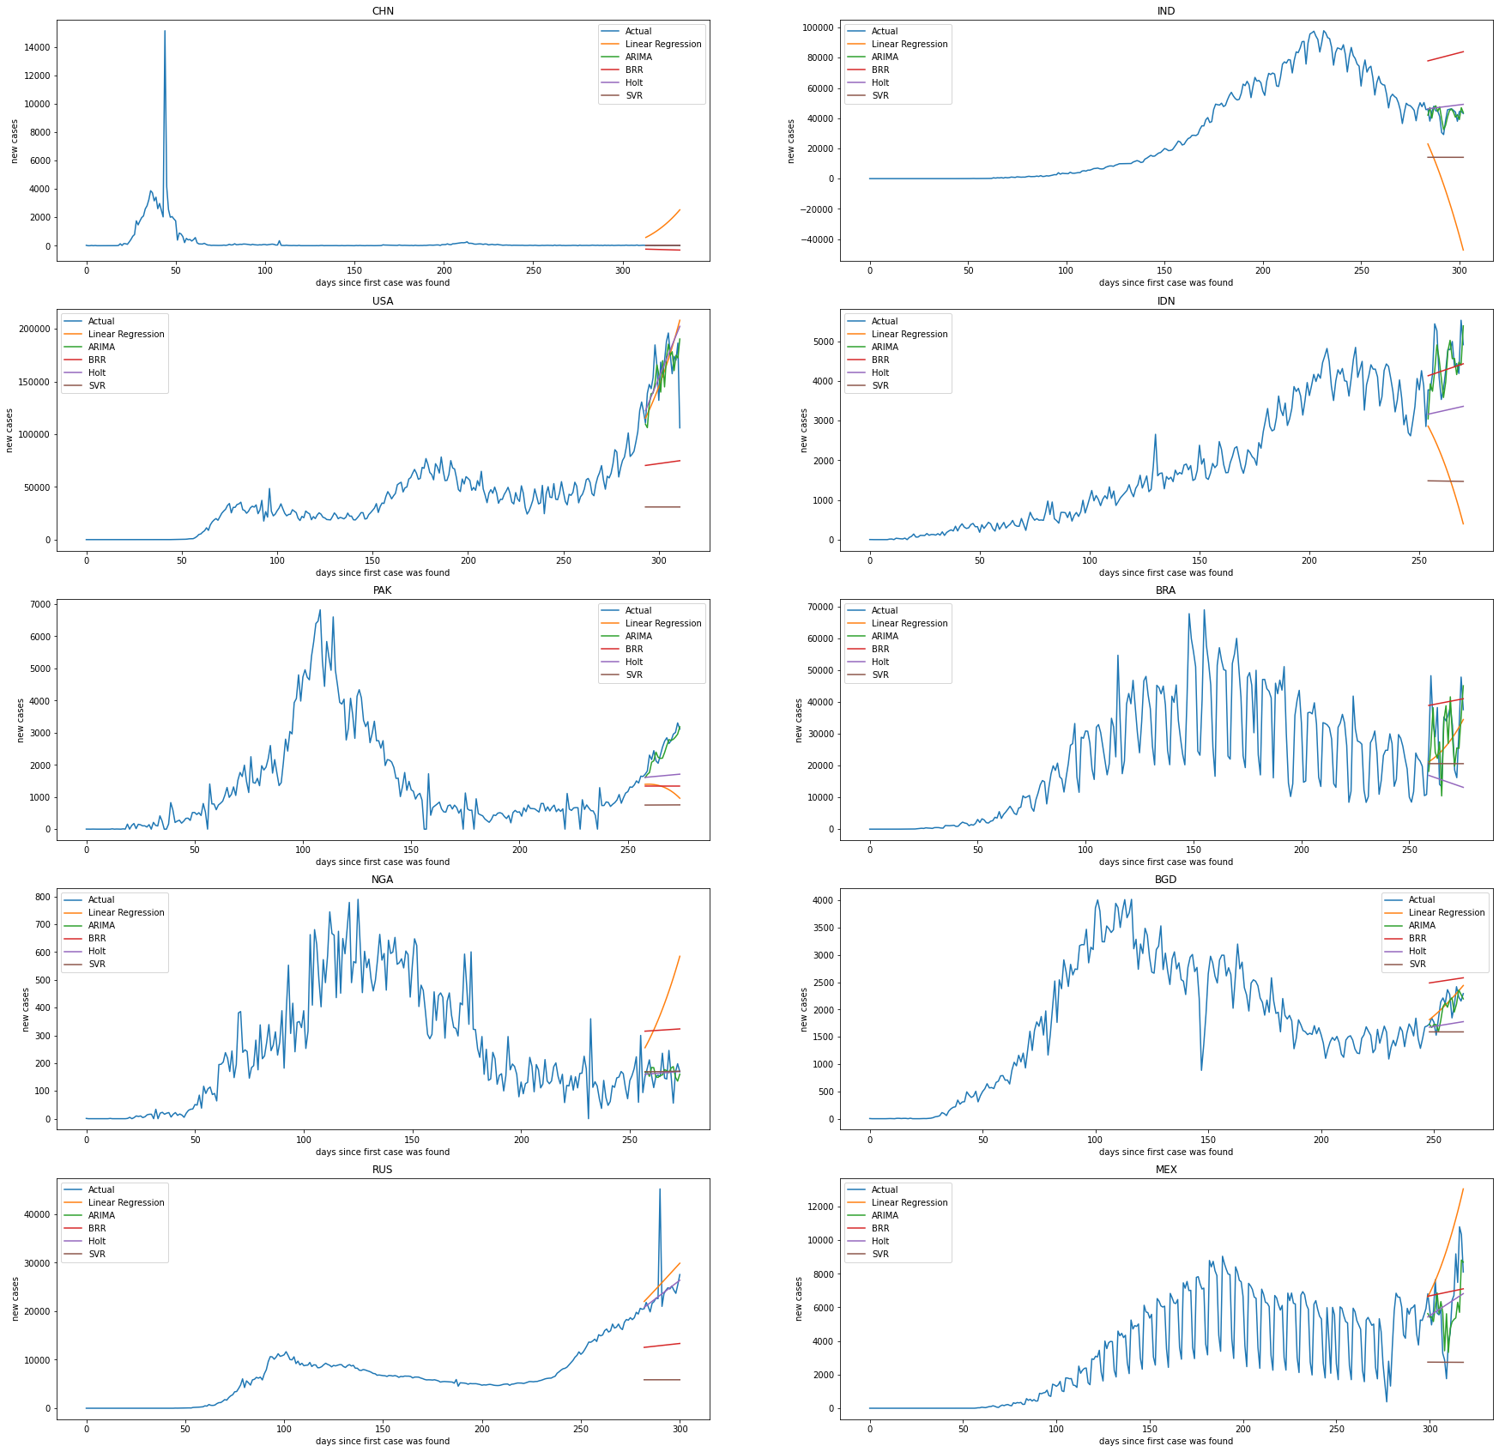

Slide 27
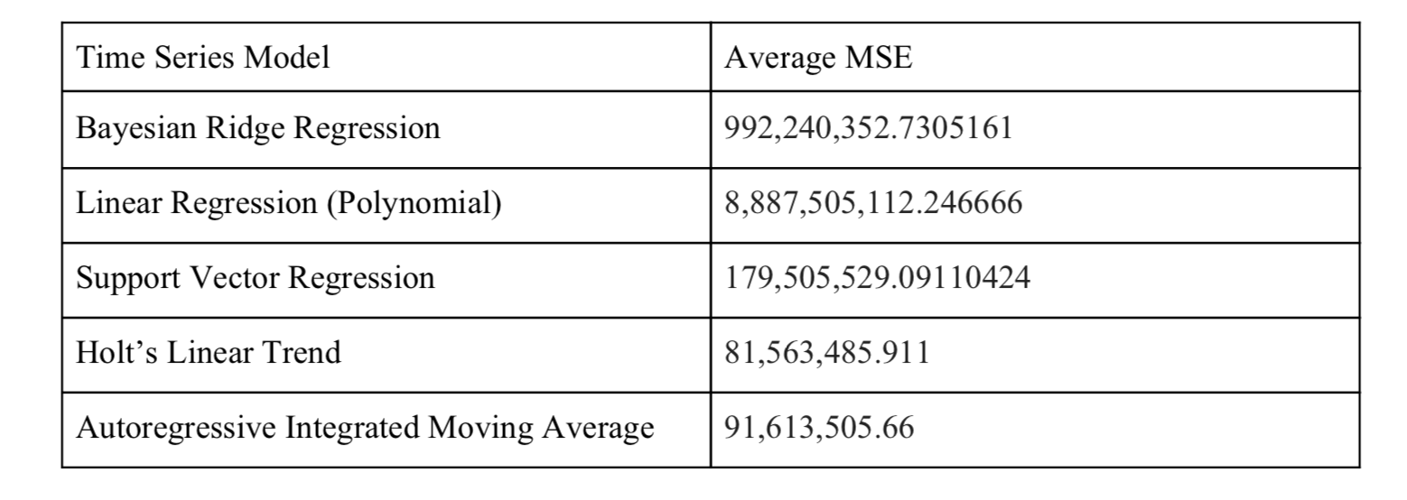

Slide 28
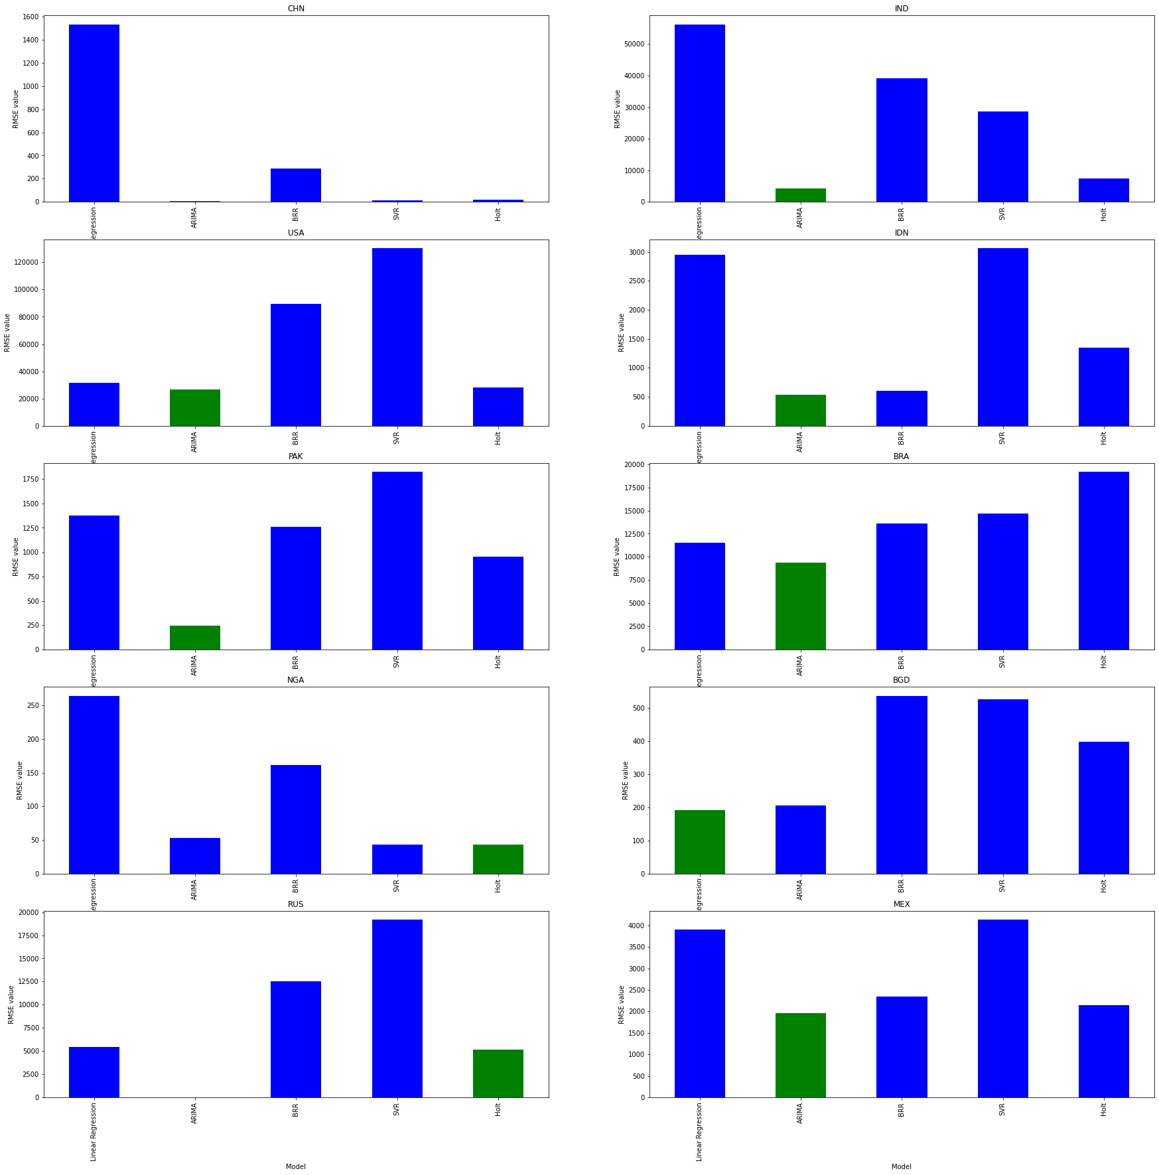
RSME

Slide 29
Obstacles We Ran Into
It hard to schedule times to collaborate together virtually
Had a hard time determining the dataset and what data we want to predict
Wanted a to find a relevant dataset that would be interesting to analyze
Not being able to apply the machine learning models we learned in class
Considered switching datasets but we found COVID-19 data to be the most interesting

Slide 30
What We Learned
4 different types of regression models and their behavior
COVID-19 cases surprisingly have no correlation with many of the attributes for each country (GDP, population density, etc.)
Showcases importances of having strict public health guidelines and regulations
No model that consistently & accurately predicts cases for countries
Estimating the number of new cases per day is highly complex
Some models work better on specific countries
For example, ARIMA doesn’t work at all on Russia dataset
Wear a mask

Slide 31
Thank you!

